Slide 1
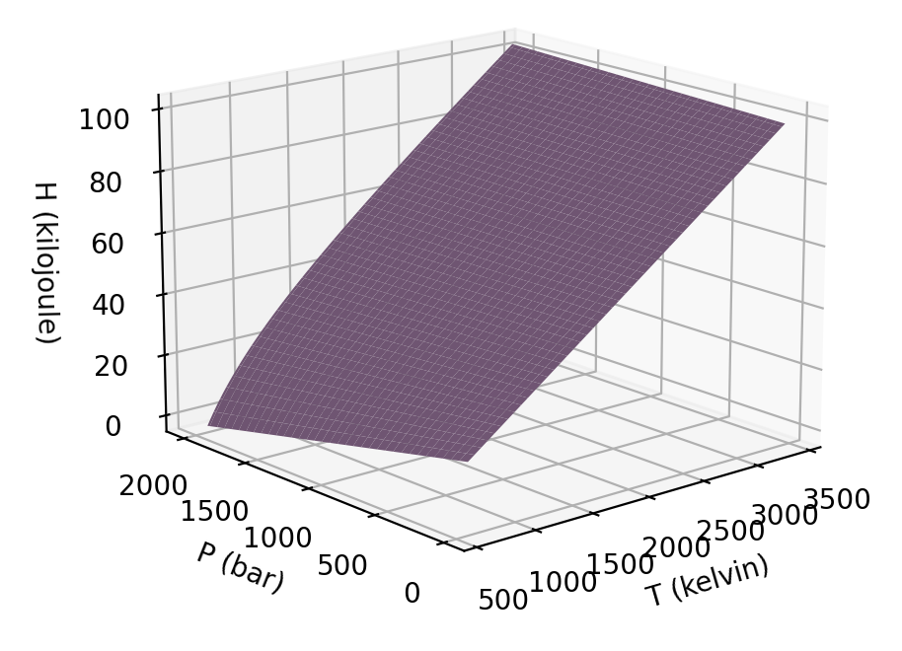
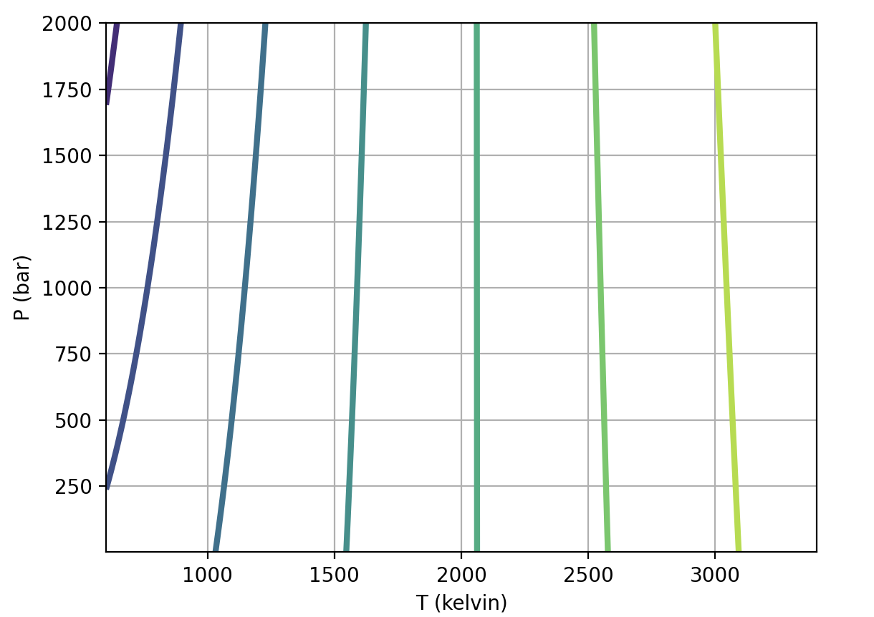
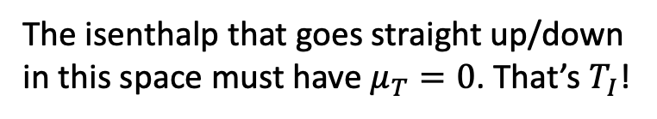
Last time: we introduced the enthalpy $H$ in a temperature-pressure state space
The isenthalp that goes straight up/down in this space must have $μ_{T}=0$. That’s $T_{I}$!
Isenthalps
Isotherms

Slide 2
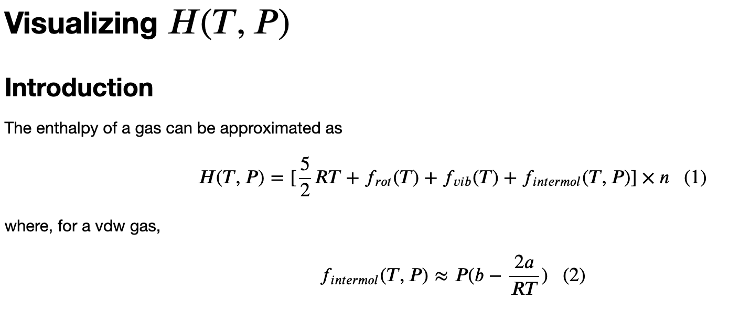
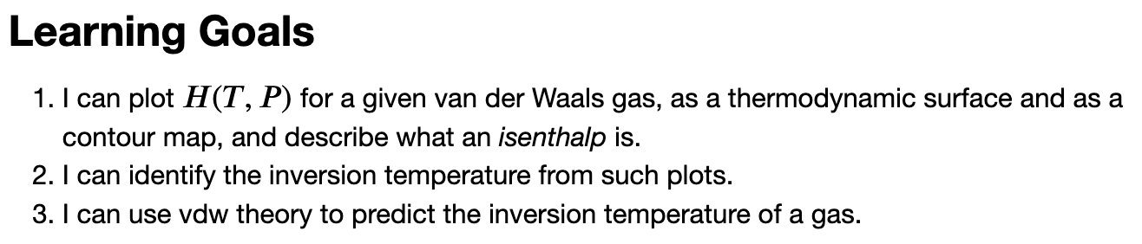
Let’s get some hands-on familiarity with this

Slide 3
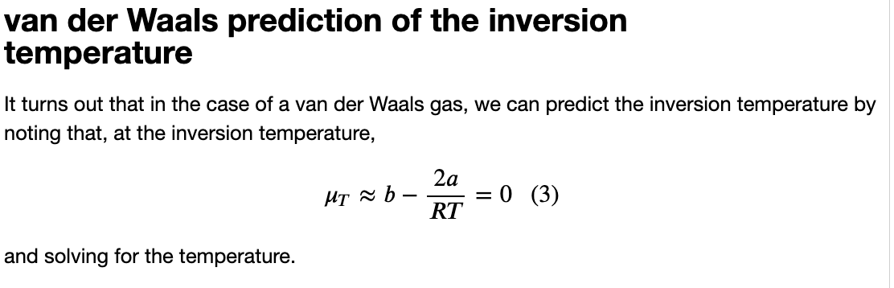
In groups: predict the inversion temperature for a vdw gas

Slide 4
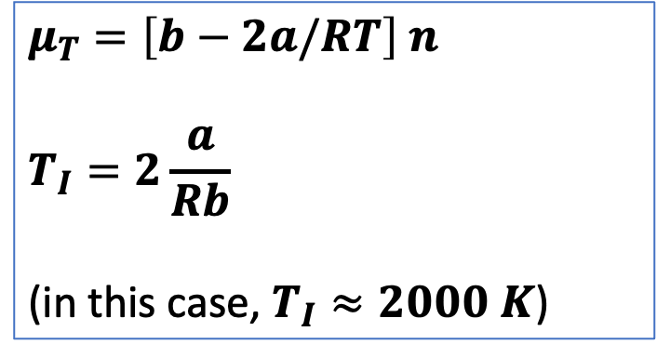
In groups: predict the inversion temperature for a vdw gas (hopefully you get this)
$$μ_{T}=\left[b−2a/RT\right] n$$
$$T_{I}=2\frac{a}{Rb}$$
(in this case, $T_{I}≈2000 K$)

Slide 5
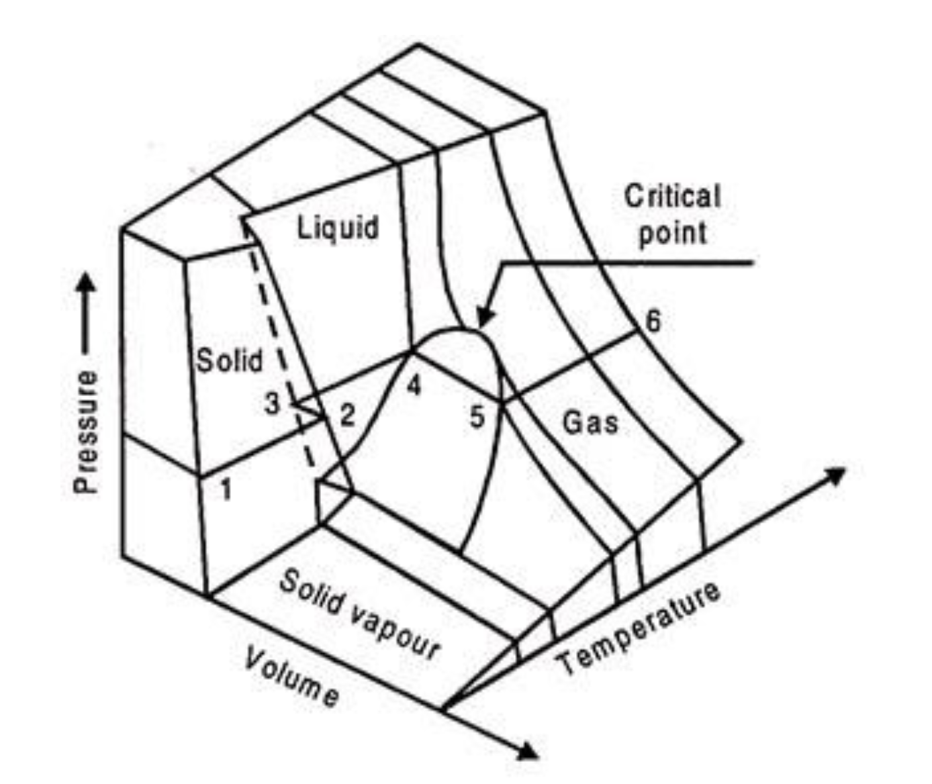



Remember we talked about $\frac{a}{Rb}$ as a unifying idea
$$T_{I}≈2\frac{a}{Rb}$$
$T_{Boyle}≈\frac{a}{Rb}$
$T_{crit}≈\frac{1}{3}\frac{a}{Rb}$
So $T_{I}>T_{Boyle}>T_{crit}$
https://www.engineeringenotes.com/thermal-engineering/real-gases/real-gases-properties-van-der-waals-equation-and-equation-of-state-thermal-engineering/49112

Slide 6
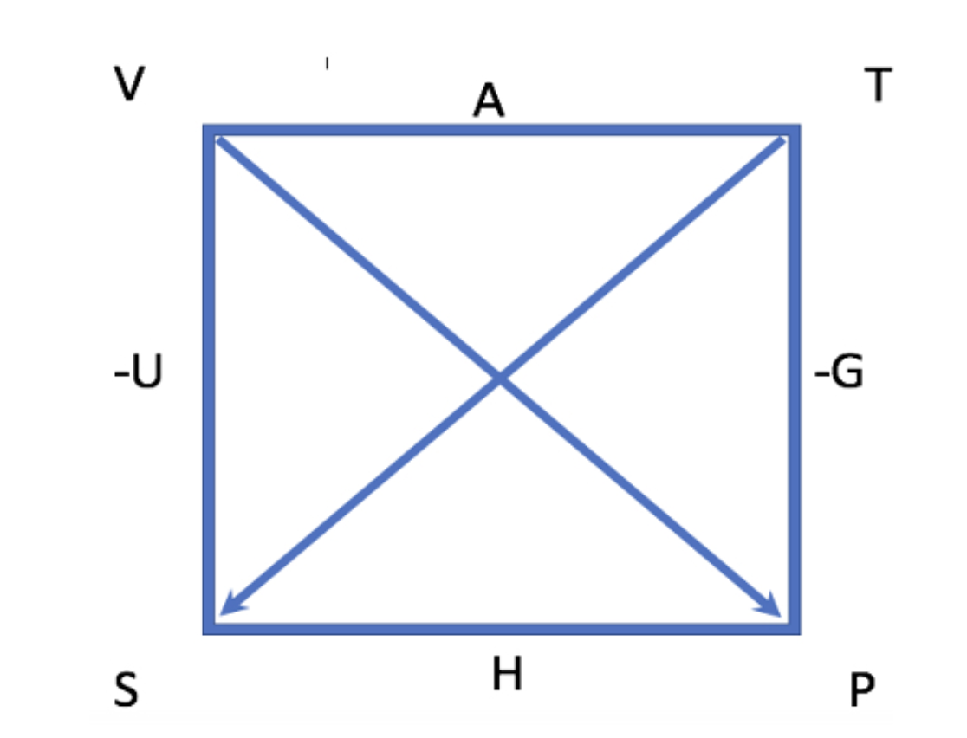
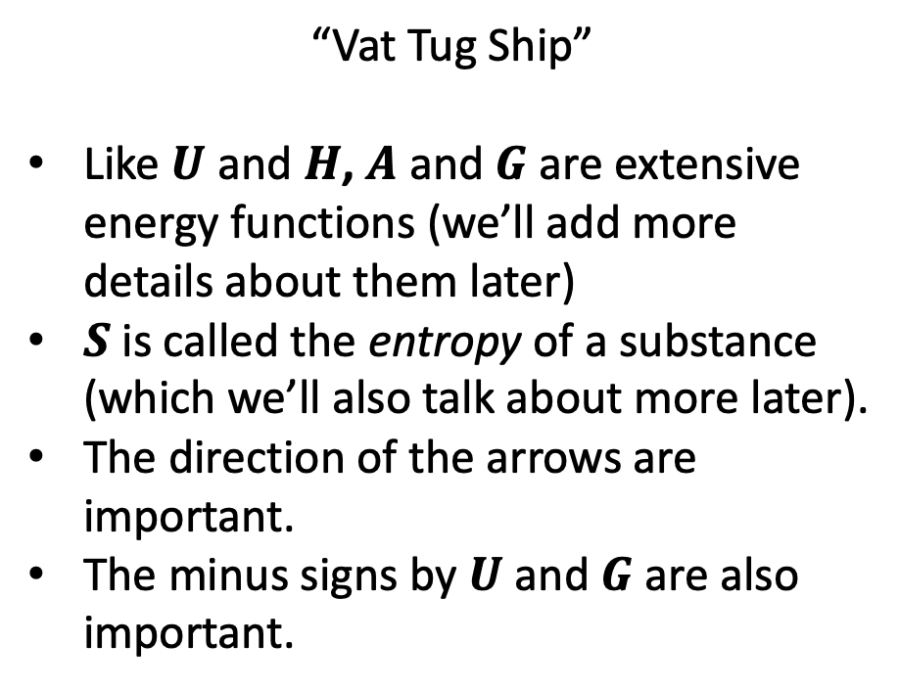
Another unifying idea: the Box
“Vat Tug Ship”
Like $U$ and $H$, $A$ and $G$ are extensive energy functions (we’ll add more details about them later)
$S$ is called the entropy of a substance (which we’ll also talk about more later).
The direction of the arrows are important.
The minus signs by $U$ and $G$ are also important.

Slide 7
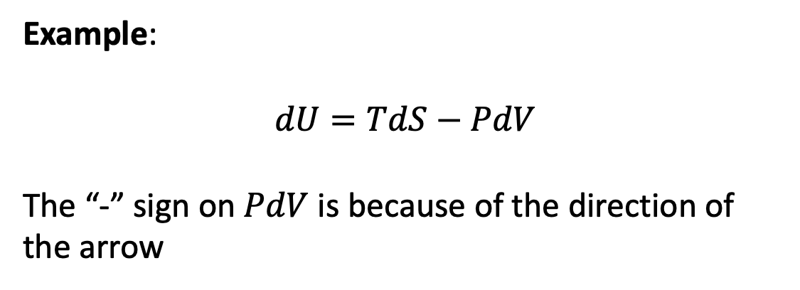
#1. Using the Box to get differential equations of state
Example:
$$dU=TdS−PdV$$
The “-” sign on $PdV$ is because of the direction of the arrow

Slide 8
#1. Using the Box to get differential equations of state
Example:
$$dU=TdS−PdV$$
The “-” sign on $PdV$ is because of the direction of the arrow
Your turn: use the box to derive differential equations of state for $H$ and $G$.

Slide 9
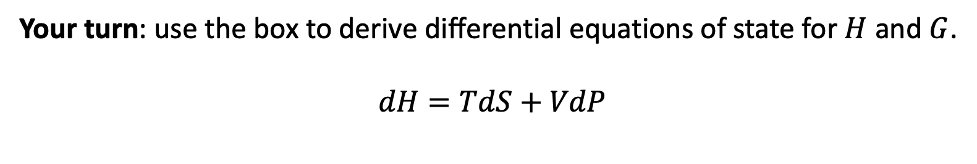
#1. Using the Box to get differential equations of state
Example:
$$dU=TdS−PdV$$
The “-” sign on $PdV$ is because of the direction of the arrow
Your turn: use the box to derive differential equations of state for $H$ and $G$.
$$dH=TdS+VdP$$

Slide 10
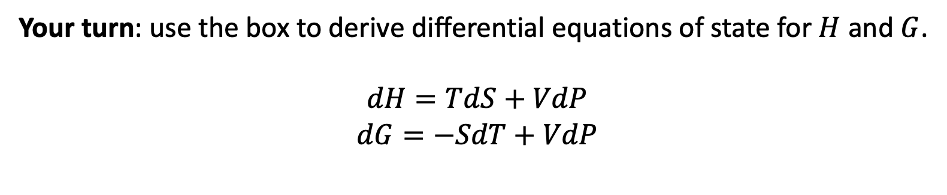
#1. Using the Box to get differential equations of state
Example:
$$dU=TdS−PdV$$
The “-” sign on $PdV$ is because of the direction of the arrow
Your turn: use the box to derive differential equations of state for $H$ and $G$.
$$dH=TdS+VdP$$
$$dG=−SdT+VdP$$

Slide 11
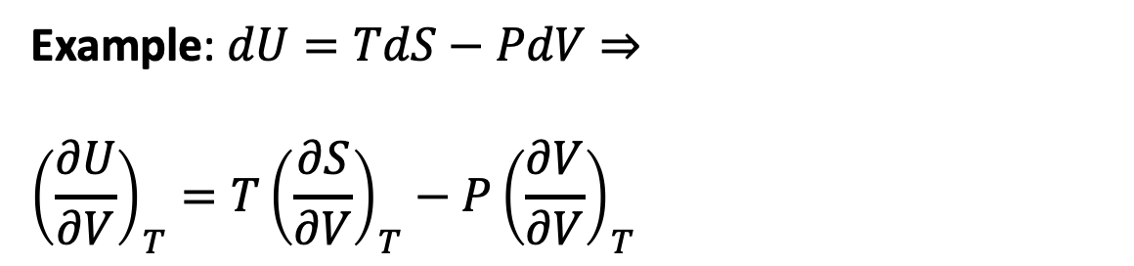
Why #1 is useful: differential equations of state get us slopes
Example: $dU=TdS−PdV⇒$
$${\left(\frac{∂U}{∂V}\right)}_{T}=T{\left(\frac{∂S}{∂V}\right)}_{T}−P{\left(\frac{∂V}{∂V}\right)}_{T}$$

Slide 12
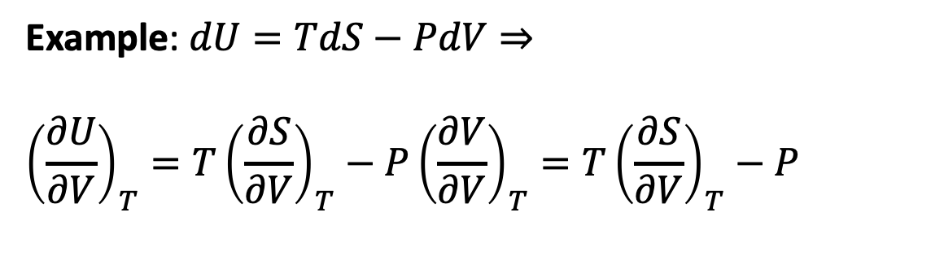
Why #1 is useful: differential equations of state get us slopes (here we also used a no-brainer)
Example: $dU=TdS−PdV⇒$
$${\left(\frac{∂U}{∂V}\right)}_{T}=T{\left(\frac{∂S}{∂V}\right)}_{T}−P{\left(\frac{∂V}{∂V}\right)}_{T}=T{\left(\frac{∂S}{∂V}\right)}_{T}−P$$

Slide 13
Why #1 is useful: differential equations of state get us slopes (here we also used a no-brainer)
Example: $dU=TdS−PdV⇒$
$${\left(\frac{∂U}{∂V}\right)}_{T}=T{\left(\frac{∂S}{∂V}\right)}_{T}−P{\left(\frac{∂V}{∂V}\right)}_{T}=T{\left(\frac{∂S}{∂V}\right)}_{T}−P$$
(Used a no-brainer)

Slide 14
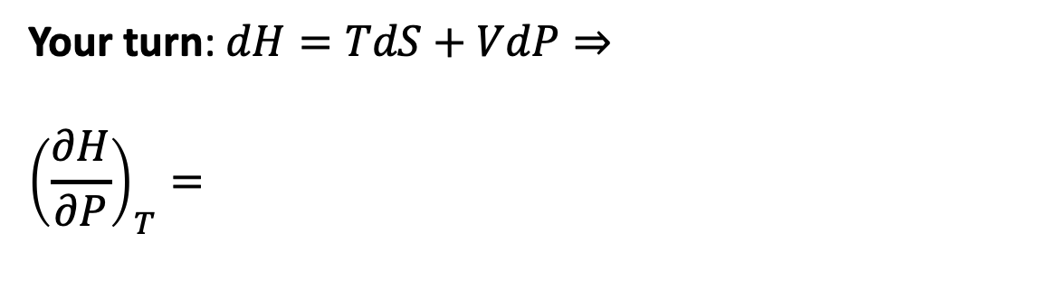
Why #1 is useful: differential equations of state get us slopes
Your turn: $dH=TdS+VdP⇒$
$${\left(\frac{∂H}{∂P}\right)}_{T}=$$

Slide 15
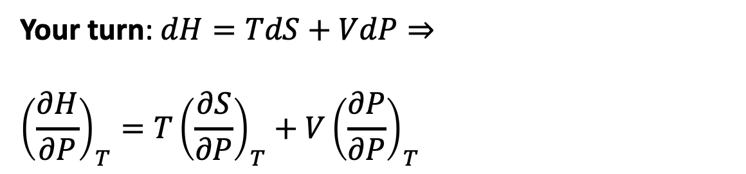
Why #1 is useful: differential equations of state get us slopes
Your turn: $dH=TdS+VdP⇒$
$${\left(\frac{∂H}{∂P}\right)}_{T}=T{\left(\frac{∂S}{∂P}\right)}_{T}+V{\left(\frac{∂P}{∂P}\right)}_{T}$$

Slide 16
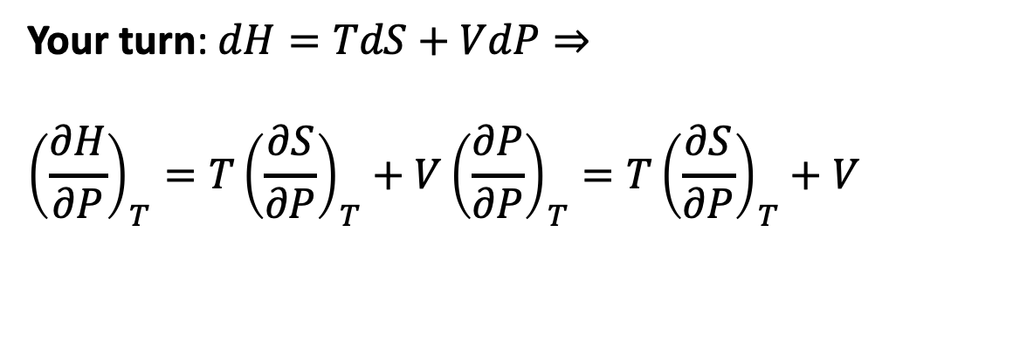
Why #1 is useful: differential equations of state get us slopes (here we also used a no-brainer)
Your turn: $dH=TdS+VdP⇒$
$${\left(\frac{∂H}{∂P}\right)}_{T}=T{\left(\frac{∂S}{∂P}\right)}_{T}+V{\left(\frac{∂P}{∂P}\right)}_{T}=T{\left(\frac{∂S}{∂P}\right)}_{T}+V$$

Slide 17
#2. Using the Box to get Maxwell relations
Example:

Slide 18
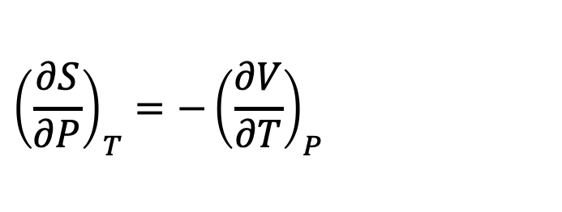
#2. Using the Box to get Maxwell relations
Example:
$${\left(\frac{∂S}{∂P}\right)}_{T}{=−\left(\frac{∂V}{∂T}\right)}_{P}$$

Slide 19
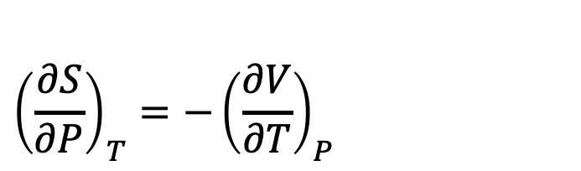
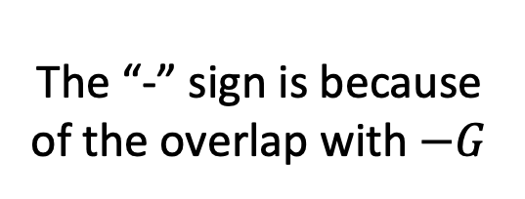
#2. Using the Box to get Maxwell relations
Example:
$${\left(\frac{∂S}{∂P}\right)}_{T}{=−\left(\frac{∂V}{∂T}\right)}_{P}$$
The “-” sign is because of the overlap with $−G$

Slide 20

#2. Using the Box to get Maxwell relations
Your turn:
$${\left(\frac{∂P}{∂S}\right)}_{V}= …$$

Slide 21
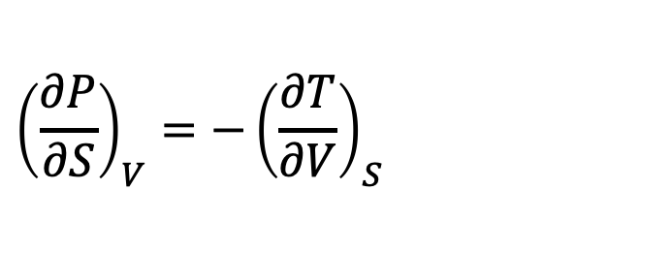
#2. Using the Box to get Maxwell relations
Your turn:
$${\left(\frac{∂P}{∂S}\right)}_{V}=−{\left(\frac{∂T}{∂V}\right)}_{S}$$

Slide 22
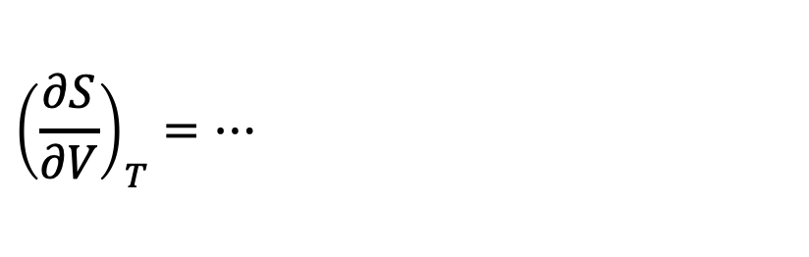
#2. Using the Box to get Maxwell relations
Your turn:
$${\left(\frac{∂S}{∂V}\right)}_{T}=…$$

Slide 23
#2. Using the Box to get Maxwell relations
Your turn:
$${\left(\frac{∂S}{∂V}\right)}_{T}=…$$

Slide 24
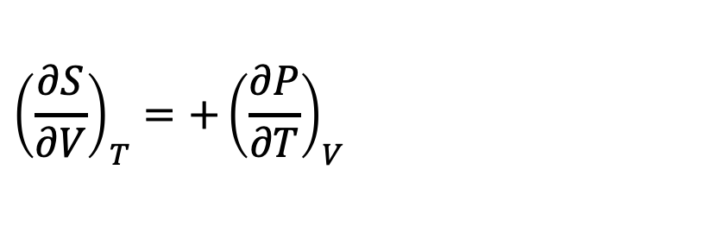
#2. Using the Box to get Maxwell relations
Your turn:
$${\left(\frac{∂S}{∂V}\right)}_{T}=+{\left(\frac{∂P}{∂T}\right)}_{V}$$

Slide 25

Blackboard work: Use #1 and #2 to find expressions for $π_{T}$ and $μ_{T}$ that have only $P$, $T$, and $V$.
$$π_{T}=…$$
$$μ_{T}=…$$

Slide 26

Blackboard work: Use #1 and #2 to find expressions for $π_{T}$ and $μ_{T}$ that have only $P$, $T$, and $V$.
$$π_{T}={T\left(\frac{∂P}{∂T}\right)}_{V}−P$$
$$μ_{T}=…$$

Slide 27

Blackboard work: Use #1 and #2 to find expressions for $π_{T}$ and $μ_{T}$ that have only $P$, $T$, and $V$.
$$π_{T}={T\left(\frac{∂P}{∂T}\right)}_{V}−P$$
$$μ_{T}={−T\left(\frac{∂V}{∂T}\right)}_{P}+V$$

Slide 28
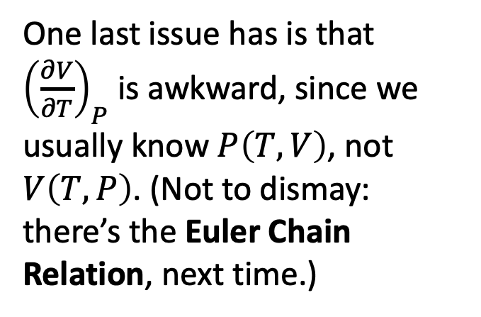
Blackboard work: Use #1 and #2 to find expressions for $π_{T}$ and $μ_{T}$ that have only $P$, $T$, and $V$.
$$π_{T}={T\left(\frac{∂P}{∂T}\right)}_{V}−P$$
$$μ_{T}={−T\left(\frac{∂V}{∂T}\right)}_{P}+V$$
One last issue has is that ${\left(\frac{∂V}{∂T}\right)}_{P}$ is awkward, since we usually know $P\left(T,V\right)$, not $V\left(T,P\right)$. (Not to dismay: there’s the Euler Chain Relation, next time.)

